Slide 1
Goals this Week
1. Understand the role of PHP 2. Upload and view a PHP file on your server

Slide 2
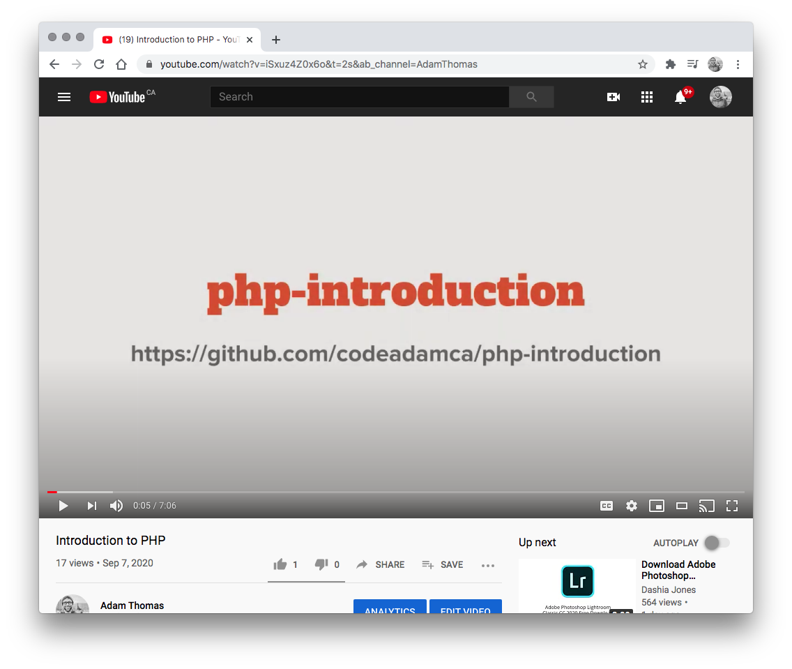

1. YouTube Videos
Watch the Following Youtube Videos:
PHP Introduction https://www.youtube.com/watch?v=iSxuz4Z0x6o
PHP Big Picture https://www.youtube.com/watch?v=Z-RBkW2E8cc
Optional:
Setting up a Local Server https://www.youtube.com/watch?v=gDfUT0Bm2m4

Slide 3
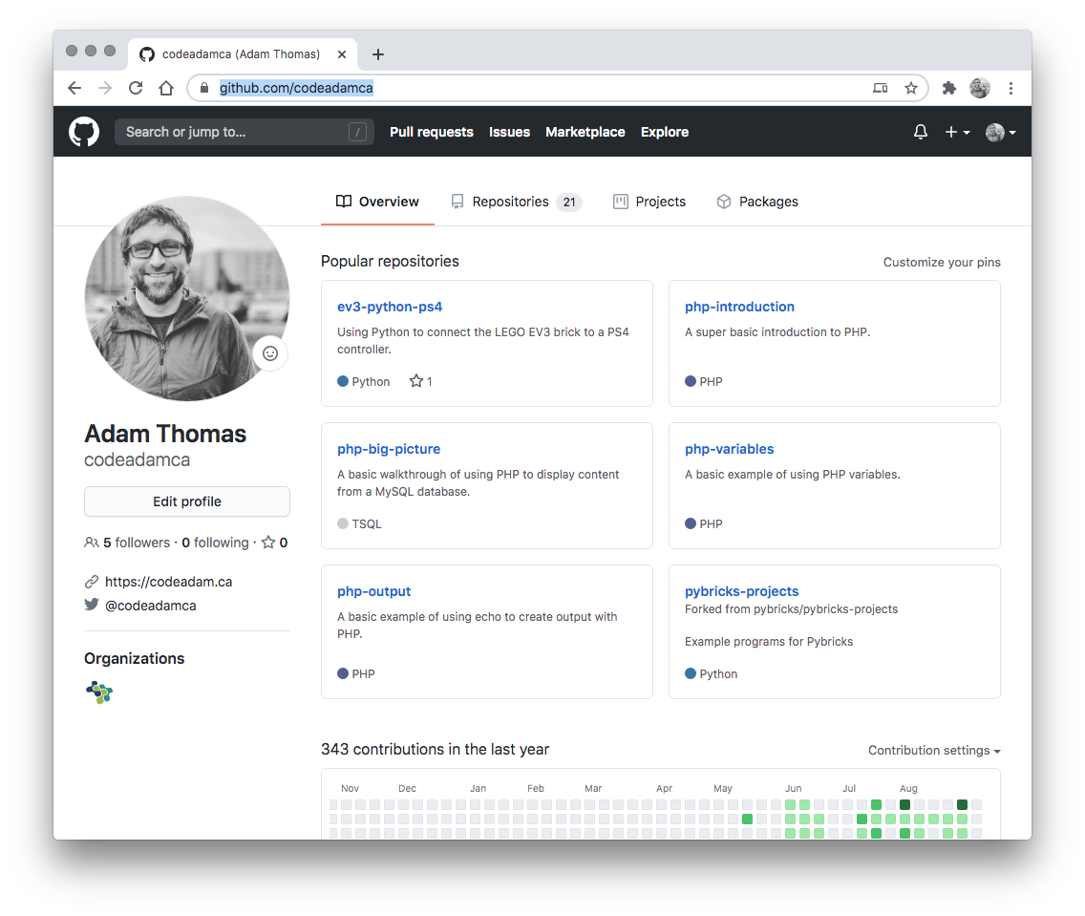

2. Review Code
Review the provided code and follow along with any coding instructions in GitHub:
PHP Introduction https://github.com/codeadamca/php-introduction
PHP Big Picture https://github.com/codeadamca/php-big-picture

Slide 4
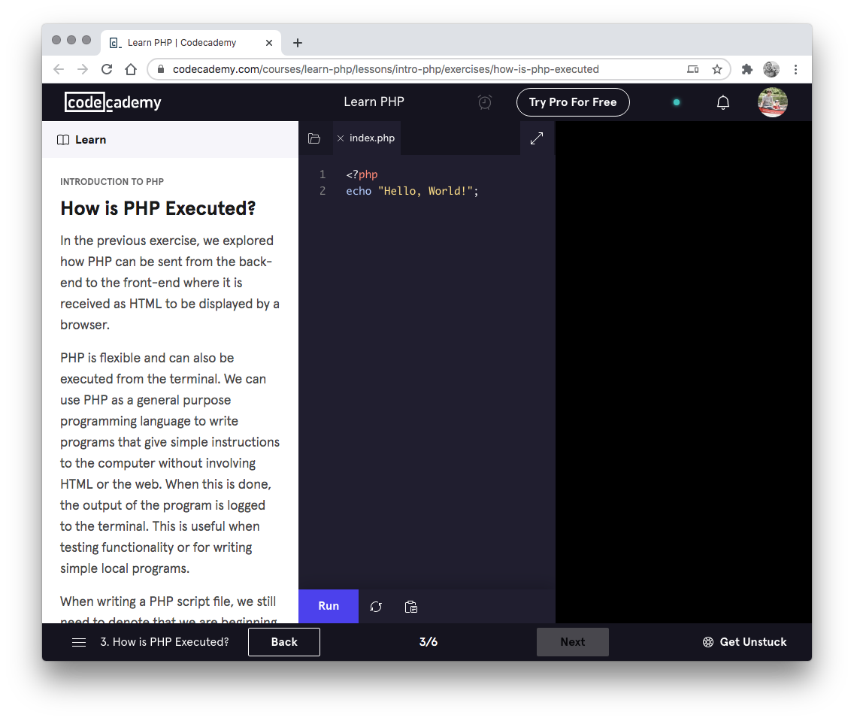

3. Codecademy
Complete the following Codecademy exercises:
Introduction to PHP: https://www.codecademy.com/learn/learn-php-introduction

